Slide 1


ONLINE ADMISSION TEST AND PROCTORING (2022-2023)
Advisor : Sir Ali Shaukat

Slide 2



Infographic Style
Team Members
Hamid Ali 2019144
Mian Ali Shah
2019235
Ameer Hamza
2019293

Slide 3
Evaluation Criteria of title defense
Rubrics | PLO1 | PLO2 | PLO8 | PLO12 | Marks
Problem statement clearly defined |  | ✓ |  |  | 5
Motivation/Justification/Ethical Impact |  |  | ✓ |  | 5
Literature Review |  |  |  | ✓ | 5
In-depth engineering/computing knowledge required | ✓ |  |  |  | 5
Involve at least one of the following attributes: wide-ranging/conﬂicting technical issues, no obvious solution, infrequently encountered issues, diverse groups of stakeholders, or component parts/sub-problems. |  |  |  |  | 5

Slide 4
Problem statement clearly defined
Total marks 5 This slide must be present in your presentation During presentation you will read this slide

Slide 5

Problem Statement
Remote proctor examinations is an important limiting factor to the scalability of this next stage in education.
Limitations in Existing system
Simultaneously Proctoring is not possible.
If a student misses an exam rescheduling exam is not possible.
Difficult to interface for students and it is not user friendly for students.
Balanced and random categorization of questions in exam is not available
Proposed system
We have proposed a web based system to identify and analyze the mal practices carried out by tHE students during online exam using Artificial intelligence.

Slide 6
Type of Project?
This is a software based Project

Slide 7
Proposed Features
1
Screenshots of webcam and screen at random interval
AI Proctoring (Irrelevant application detection, Double face detection, Face spoofing, Eye Tracking, Mouth Opening detection, Mobile Phone detection, etc)
2
3
Bluetooth devices detection(Projector, etc)
Audio detector
4
4
IP and Mac Address Validation
5

Slide 8
Proposed Features
6
Keyboard Typing detection
7
Large Question Bank
8
Ability to import / export question
4

Slide 9
Application
(i) Admission test for universities
(ii) Distance Learning Certification

Slide 10
Motivation/Justification/Ethical Impact/Socio-economic Impact
Total marks 5 This slide must be present in your presentation During presentation you will read this slide

Slide 11
Motivation for the Project
Candidates do not have to waste time walking from one location to another to complete their examination.
The Key advantages of the distant online entrance exam is the convenience of administration.
The results are much quicker, as the software can mark and present the results for the candidates
It saves the administrator a lot of time.

Slide 12
Justification of Scope
In Pakistan, the number of internet users have nearly quadruple in the past 3 years.
According to researchers, 37 % of students preferred remotely instruction, compared to 9% who prefer a hybrid model and 54 % who reported they'd rather learn in person.
This proved to be a windfall for academics as many students could continue their education remote via internet
This also facilitated examinations to go online which brought the concept of online proctoring at the academic level.
A proctored exam allows the invigilators to invigilate remotely.
.

Slide 13

Ethical Impact
The ability to efficiently proctor remote online examinations is an important limiting factor to the scalability of this next stage in education.
10%
40%
20%
30%

Slide 14
Literature Review
Total marks 5 This slide must be present in your presentation During presentation you will read this slide

Slide 15
Literature Review
In paper [1] the authors studied the testing pattern grades in four e-campus courses at Troy University with 76 graduate students. The research found major differences in average test grade scores between tests taken remote online without a proctor and with proctor.
In paper [2] To demonstrate and maintain academic integrity, some institutions require proctor supervision of online exams.
In paper [3] Online education continues to grow, bringing opportunities and challenges for students and instructors. One challenge is the perception that academic integrity associated with online tests is compromised due to undetected cheating that yields artificially higher grades.

Slide 16


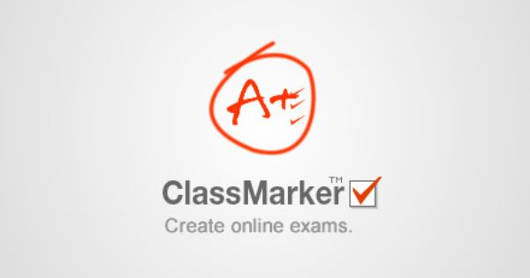
Comparison with existing systems
Existing Systems
Comparison table of existing systems and our proposed system
Features | Proposed System | Class Marker | Microsoft Teams | Proctor track
AI Proctoring | yes | No | No | Yes
Screenshot(at random interval) | yes | No | No | No
Mac Address Matching | yes | No | No | No
Bluetooth devices detection | yes | No | No | No

Slide 17
In-depth Engineering/ Computing Knowledge
Total marks 5 This slide must be present in your presentation During presentation you will read this slide

Slide 18





Tools & Technology

Slide 19
Wide Ranging Technical Issue
02
Developing a robust backend
Building an intuitive UI/UX
01
Machine learning of automated proctoring for detection of unfair means usage
03

Slide 20
Components Parts
Two individual components integrated to realize the application
Examination dashboard where questions & answers can be created in an exam. Results can be published and viewed
01
Automated Proctoring module where instructors can view live monitoring of exam and view proctoring logs of the students
02

Slide 21



Diverse Group of Stakeholders

Slide 22
References
1
E-cheating Prevention Measures: Detection of Cheating at Online Examinations Using Deep Learning Approach - A Case Study Leslie ChingOw Tiong and HeeJeong Jasmine Lee
2
Research on Abnormal Behavior Detection of Online Examination Based on Image Information Senbo Hu1 , Xiao Jia2 , Yingliang Fu3 Dalian Maritime University College of Information Science and TechnologyDalian, Liaoning Email:senbo@dlmu.edu.cn, jiaxiao222@126.com,fuyl8125@dlmu.edu.cn
.
3
Prince, D.J., Fulton, R.A. and Garsombke, T.W. 2009. Comparisons Of Proctored Versus Non-Proctored Testing Strategies In Graduate Distance Education Curriculum. Journal of College Teaching & Learning (TLC). 6, 7 (Nov. 2009). DOI:https://doi.org/10.19030/tlc.v6i7.1125.

Slide 23
Thank You
Any Questions?

